Slide 1
Sectoral organisation for Training & development Woodworking- and Furniture Industry

Slide 2
Woodworking and Furniture sector & related branches
Logging
PC 125.01
Wood & Furniture / Upholstery
PC 126
Wood trade
PC 125.03
Wood & Construction
PC 124
PLAATMATERIALEN
Sawmills
PC 125.02
Employees
PC 200

Slide 3
Employment
17.500 FTEs (+ 15.000 in wood & construction)
2.200 companies
85% < 5 FTEs
1 > 1.000 FTEs
FLANDERS
80%
BRUSSELS
2%
WALLONIA
18%

Slide 4
Woodworking and Furniture sector
Tailor made interiors
Wood & Furniture
PC 126
Wooden packaging and pallets
Furniture & seating (upholstery)
Boards and panels
Construction elements
Other products

Slide 5
WOODWIZE : SERVICES
TRAINING & LLL
Education
OSH
HR support

Slide 6
WOODWIZE : SERVICES
TRAINING & LLL for
unemployed
co-workers (OTJ – EXT)
Education
OSH
HR support

Slide 7
TRAINING & Life long learning
Our goal!
Training of the co-workers and unemployed towards the wood- and furnituresector, which is in a fast transition towards Industry 4.0
Life Long Learning: consulting and detecting of training needs; planning, development and organisation of training
In company (OTJ) and external: yearly 250.000 hours OTJ and 15.000 hours EXT

Slide 8
WOODWIZE : SERVICES
TRAINING & LLL
Education: link with labour market
VET (policy makers)
Dual learning
OSH
HR support

Slide 9
EDUCATION
Our goal!
Promotion of (the professions of) the woodworking and furniture sector towards youngsters and teachers
A better transmission from VET schools towards woodworking & furniture sector

Slide 10
EDUCATION
Towards policy makers:
reforming (VET) secundary education, STEM, Dual Learning …
Educational programs adapted to the needs of the sector:
EQF – FQS (VKS)
modular structure of VET (wood)education
Trainings and study visits
New technologies as CE marking (window frames and doors), composite materials, new technologies hinging/locking systems, …

Slide 11
Some figures VET wood education in BE
# schools in FL: 118 PSO – 47 TSO – 5 Se-a-Se wood + 4 Se-a-Se PPT – 47 PsSO – 32 L&W – 19 AE
# students: +/- 10.000 (5.500 PSO + 2.500 TSO + 120 Se-a-Se + 1.200 PsSO + 450 L&W)
# students in firms ‘wood’ (FL): +/- 2.000/year!
# schools Wall/Bxl: 83 PSO – 22 TSO - …
# students : +/- 2.000
Professional bachelors (HoGent) (level 6): +/- 380 students (3 years)

Slide 12
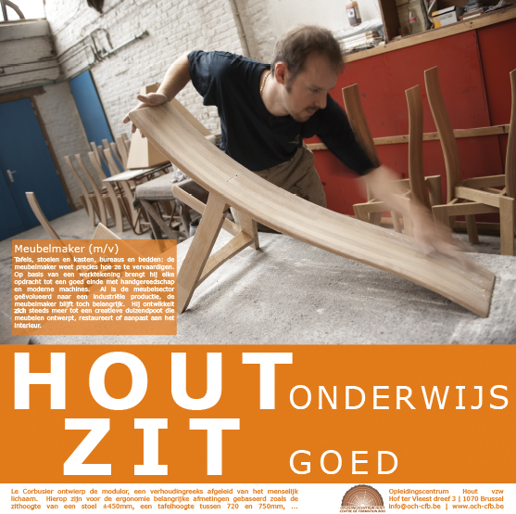
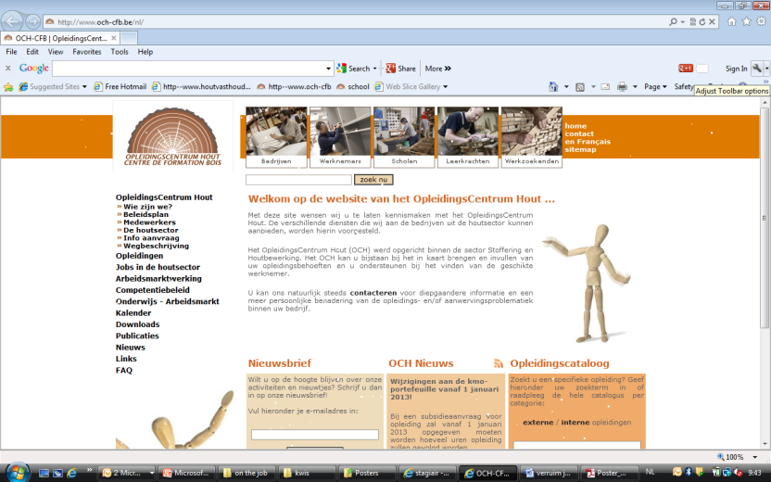
Onderwijs

Slide 13
WOODWIZE : SERVICES
TRAINING & LLL
Education
Occupational Safety and
Health
OiRA …
Well being …
HR support

Slide 14
OSH
Our goal!
Support and promotion towards the employers and co-workers in the woodworking and furniture sector towards a (sustained) policy and commitment for safety and well being of all partners and stakeholders involved.
Sensibilisation
Development of support: OiRA Wood

Slide 15
WOODWIZE : SERVICES
TRAINING & LLL
Education
OSH
HR support
T & D policy
Job seekers
Diversity & equal rights

Slide 16
HR Support
Our goal!
Training and development policy – planning
Vacancies: finding the right people for the right job
Diversity and equal rights
longer working life
Specific projects…

Slide 17
Thank you for your attention ! www.WOODWIZE.be

